Slide 1


Wilson Tsang
5 Dec 2023

Slide 2

Outline
Executive Summary
Introduction
Methodology
Results
Conclusion

Slide 3
Executive Summary
This project will include the following contents :
• Analyze the data with SQL, calculating the following statistics: total payload, payload range for successful launches, and total # of successful and failed outcomes
• Explore launch site success rates and proximity to geographical markers
• Visualize the launch sites with the most success and successful payload ranges
• Build Models to predict landing outcomes using logistic regression, support vector
machine (SVM), decision tree and Knn

Slide 4
Introduction
Background
SpaceX, a leader in the space industry, strives to make space travel affordable for everyone. Its accomplishments include sending spacecraft to the international space station, launching a satellite constellation that provides internet access and sending manned missions to space. SpaceX can do this because the rocket launches are relatively inexpensive ($62 million per launch)
By determining if the first stage will land, we can determine the price of the launch. To do this, we can use public data and machine learning models to predict whether SpaceX – or a competing company – can reuse the first stage.
We will explore
•How payload mass, launch site, number of flights, and orbits affect first-stage landing success
• Rate of successful landings over time
• Best predictive model for successful landing

Slide 5

Section 1

Slide 6
Methodology
Executive Summary
Data collection methodology:
We will collect data by REST API and web scraping techniques
Perform data wrangling
by filtering the data, handling missing values and applying one hot encoding
Perform exploratory data analysis (EDA) using visualization and SQL
Perform interactive visual analytics using Folium and Plotly Dash
Perform predictive analysis using classification models
Various models will be used with parameter search

Slide 7
Data Collection
Request data from SpaceX API (rocket launch data)
Decode response and convert to a dataframe using .json_normalize()
Request information about the launches from SpaceX API using custom functions
Create dictionary from the data
Create dataframe from the dictionary
Filter dataframe to contain only Falcon 9 launches
Replace missing values of Payload Mass with calculated .mean()
Export data to csv file

Slide 8
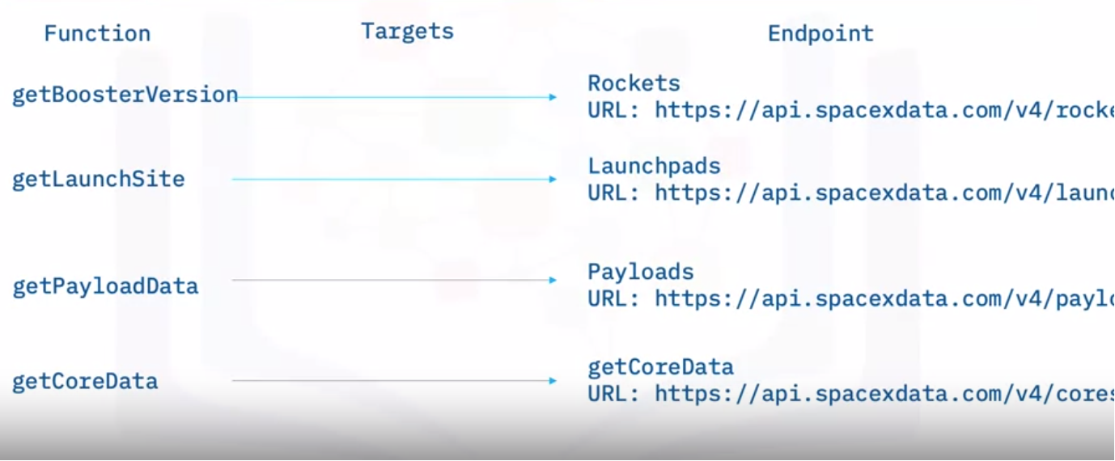
Data Collection – SpaceX API
We will use the following API to retrieve
1. Booster version
2. Launch Site
3. Payload
4. Core data

Slide 9
Data Collection - Scraping
Data is obtained from Wikipedia by Beautiful Soup library
Python Code
BeautifulSoup()
Website (Wiki)

Slide 10
Data Wrangling
• Request data (Falcon 9 launch data) from Wikipedia
• Create BeautifulSoup object from HTML response
• Extract column names from HTML table header
• Collect data from parsing HTML tables
• Create dictionary from the data
• Create dataframe from the dictionary
• Export data to csv file

Slide 11
EDA with Data Visualization
Charts to create
• Flight Number vs. Payload
• Flight Number vs. Launch Site
• Payload Mass (kg) vs. Launch Site
• Payload Mass (kg) vs. Orbit type
Analysis
• View relationship by using scatter plots. The variables could be useful for
machine learning if a relationship exists
• Show comparisons among discrete categories with bar charts. Bar charts
show the relationships among the categories and a measured value.

Slide 12
EDA with SQL
Queries to Create
• Names of unique launch sites
• 5 records where launch site begins with ‘CCA’
• Total payload mass carried by boosters launched by NASA (CRS)
• Average payload mass carried by booster version F9 v1.1.

Slide 13
EDA with SQL
We will list the following:
Date of first successful landing on ground pad
Names of boosters which had success landing on drone ship and have
payload mass greater than 4,000 but less than 6,000
Total number of successful and failed missions
Names of booster versions which have carried the max payload
Failed landing outcomes on drone ship, their booster version and launch
site for the months in the year 2015
Count of landing outcomes between 2010-06-04 and 2017-03-20 (desc)

Slide 14
Build an Interactive Map with Folium
Markers indicating Launch Sites will be created
Colored Markers of Launch Outcomes
Distance between Launch Site will be calculated

Slide 15
Build a Dashboard with Plotly Dash
Dropdown List with Launch Sites
Allow user to select all launch sites or a certain launch site
Dashboard with Plotly Dash
Slider of Payload Mass Range
Allow user to select payload mass range
Pie Chart Showing Successful Launches
Allow user to see successful and unsuccessful launches as a percent of the total
Scatter Chart Showing Payload Mass vs. Success Rate by Booster Version
Allow user to see the correlation between Payload and Launch Success

Slide 16
Predictive Analysis (Classification)
Standardize the data with StandardScaler. Fit and transform the data.
Split the data using train_test_split
Create a GridSearchCV object for parameter optimization
Apply GridSearchCV on different algorithms: logistic regression, support vector machine, decision tree, K-Nearest Neighbor
Calculate accuracy on the test data using .score() for all models
Assess the confusion matrix for all models
Identify the best model using Jaccard_Score, F1_Score and Accuracy

Slide 17
Results
Exploratory data analysis results
Interactive analytics demo in screenshots
Predictive analysis results

Slide 18

Section 2

Slide 19
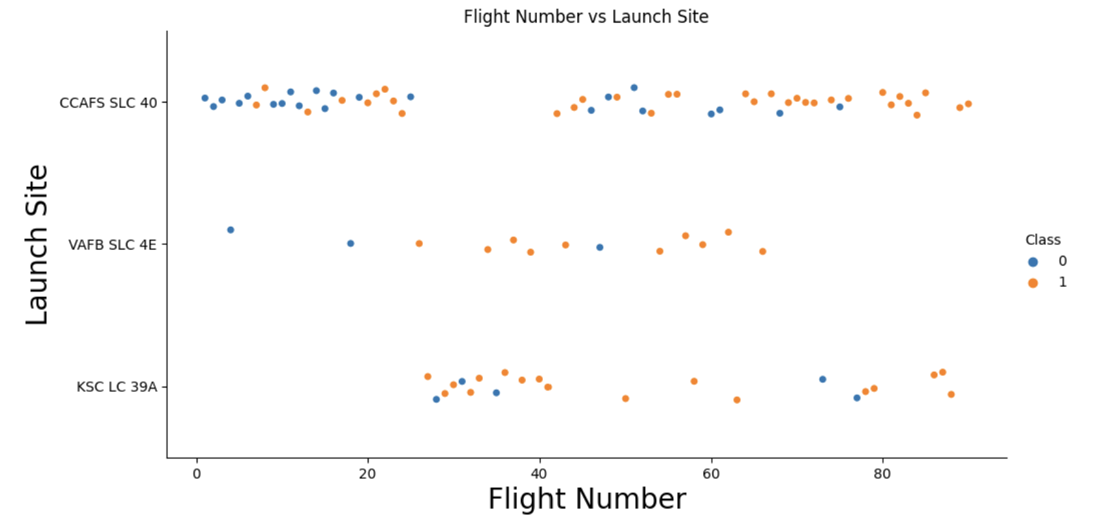
Flight Number vs. Launch Site
New flights have higher successful rate
Most launches are CCAFS

Slide 20
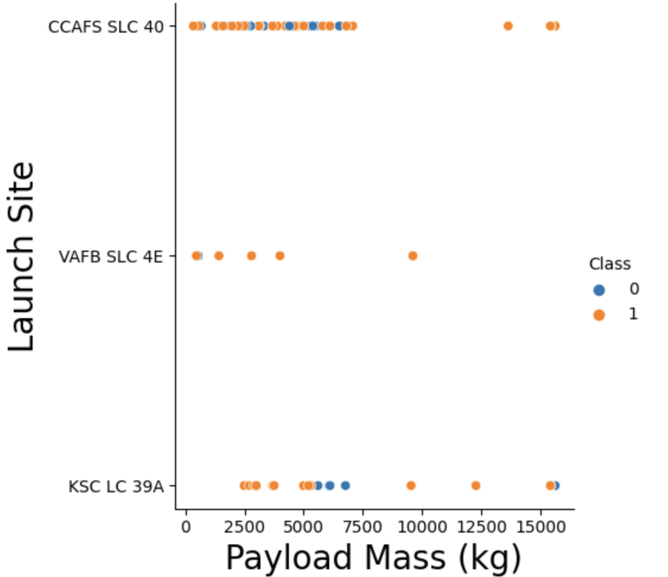
Payload vs. Launch Site
KSC LC 39A generally has higher payload
VAFB has 100% successful rate

Slide 21
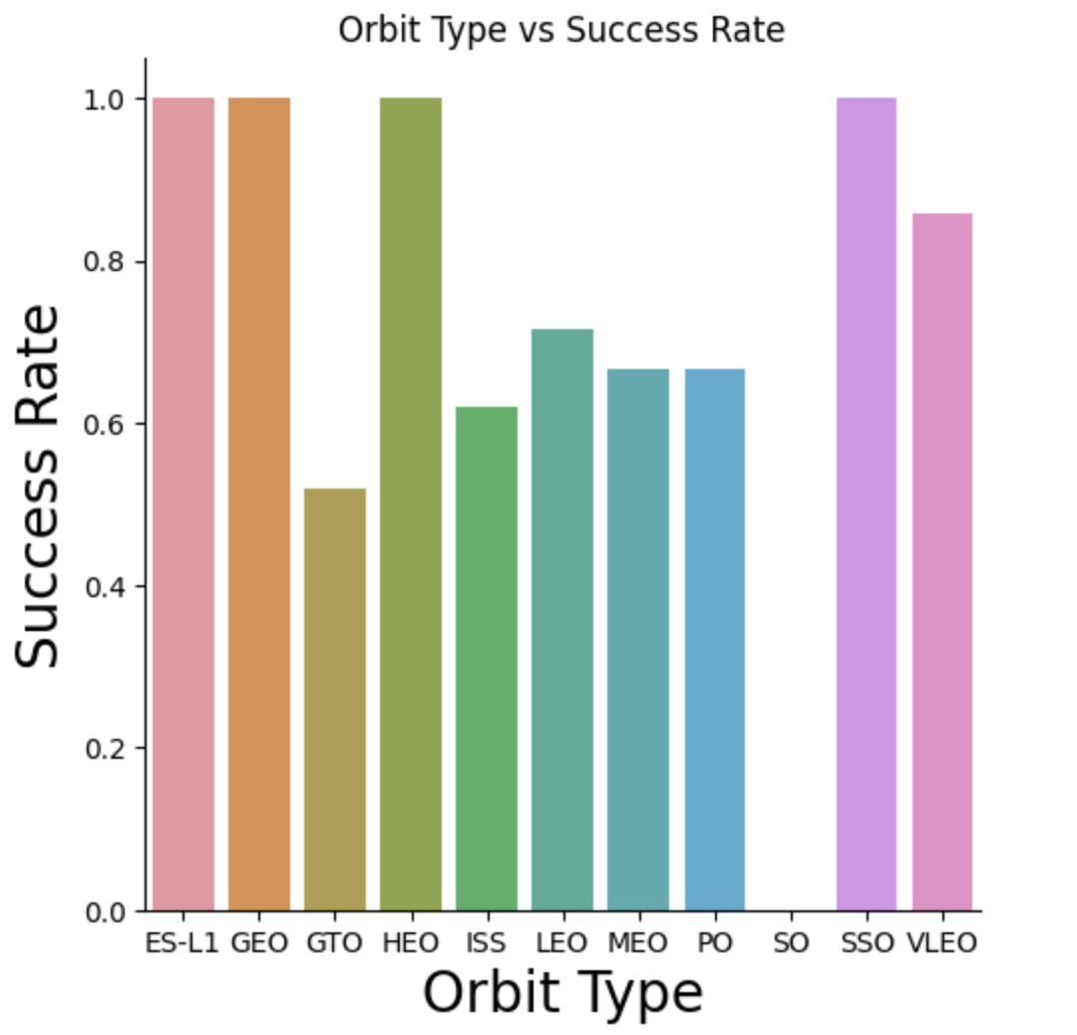
Success Rate vs. Orbit Type
• 100% Success Rate: ES-L1, GEO, HEO and SSO
• 50%-80% Success Rate: GTO, ISS, LEO, MEO, PO
• 0% Success Rate: SO

Slide 22
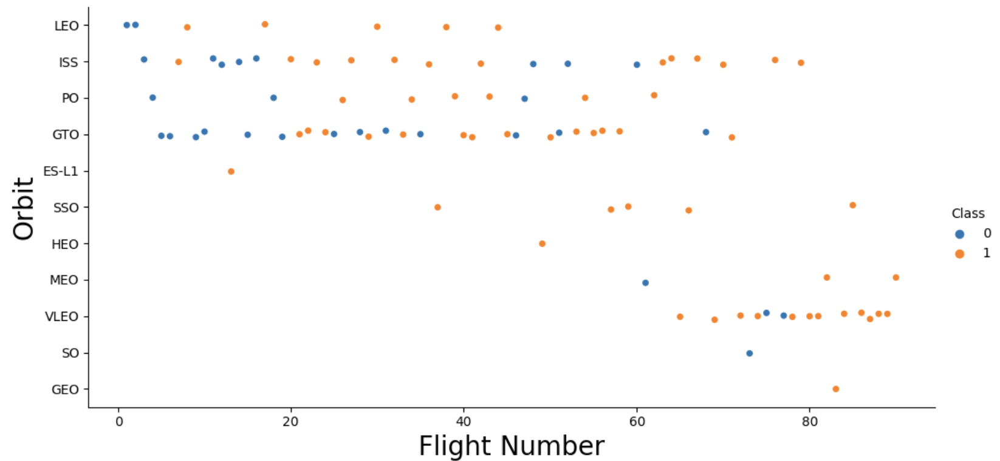
Flight Number vs. Orbit Type
The success rate typically increases with the number of flights for each orbit
All SSO recorded success

Slide 23
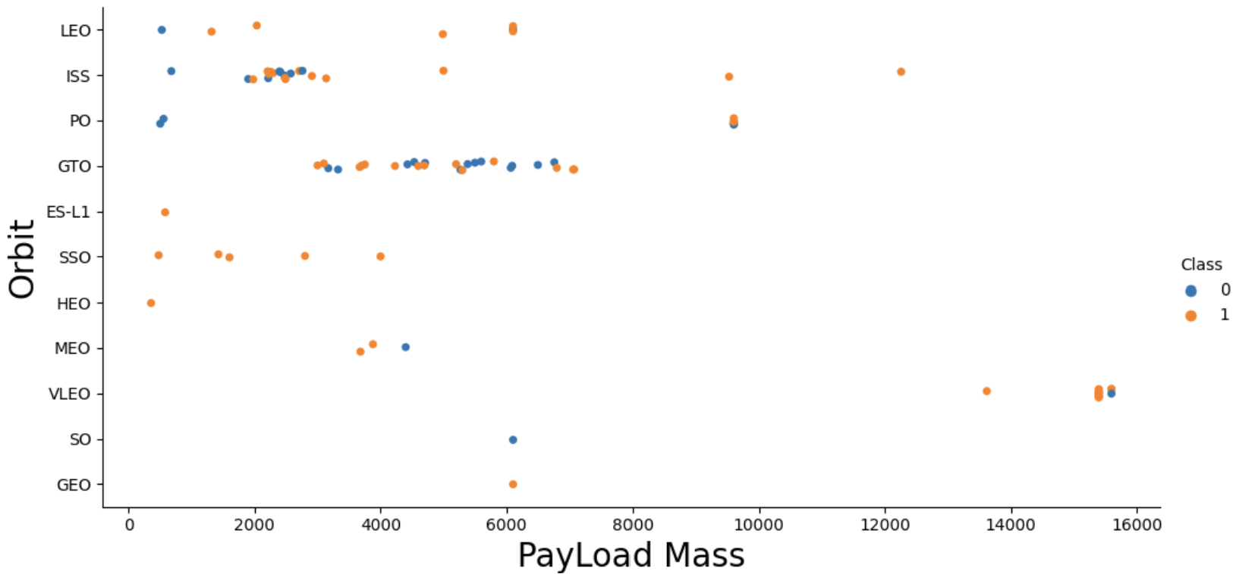
Payload vs. Orbit Type
Most failure cases lie in pay load mass between 2000 to 6000.

Slide 24
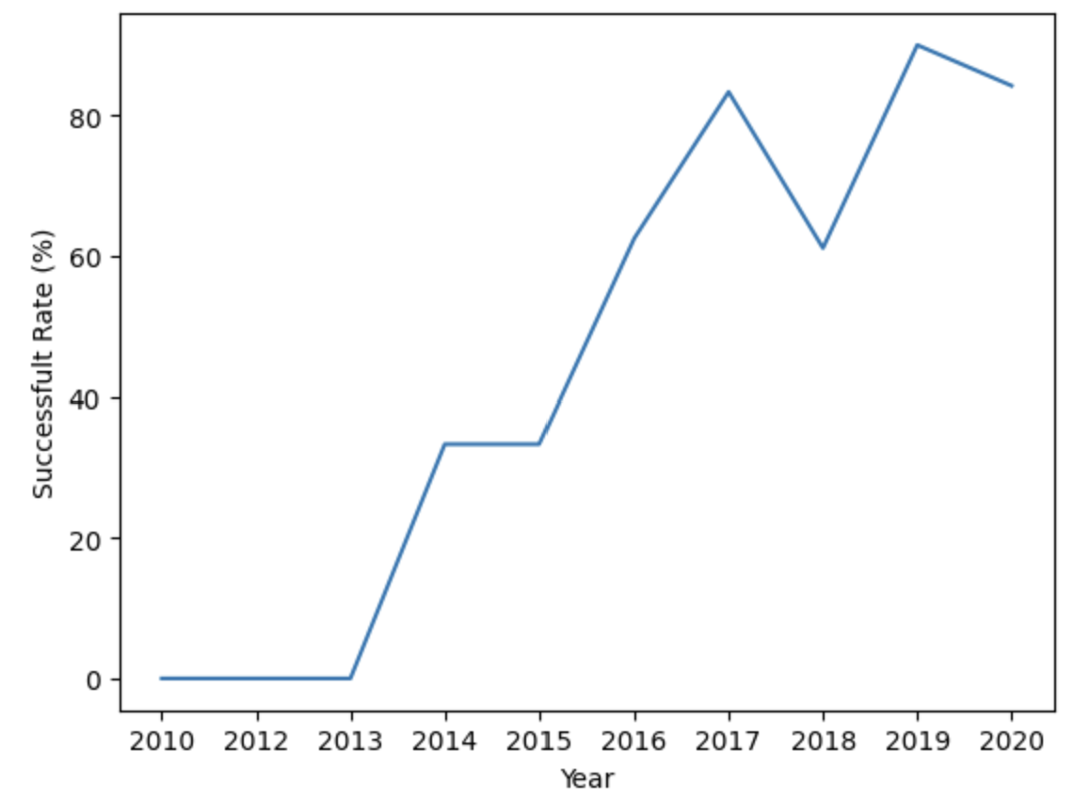
Launch Success Yearly Trend
The successful rate is 0% from 2010 to 2013.
Great improvement occurs in 2014. And the successful generally keeps improving.

Slide 25
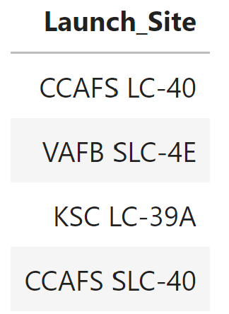
All Launch Site Names
Name of the unique launch sites
Query used

Slide 26
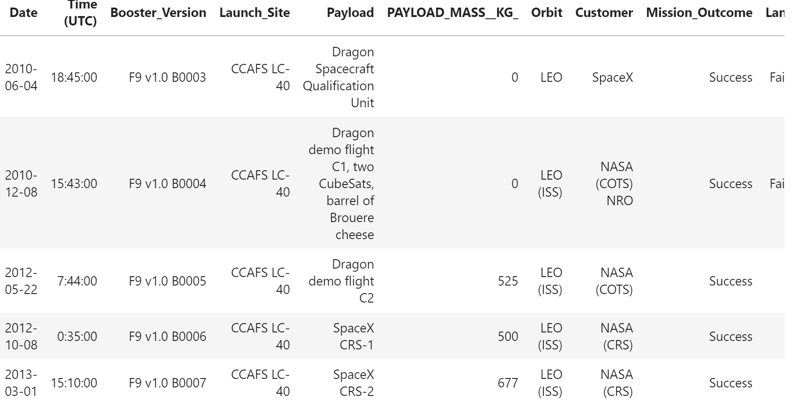
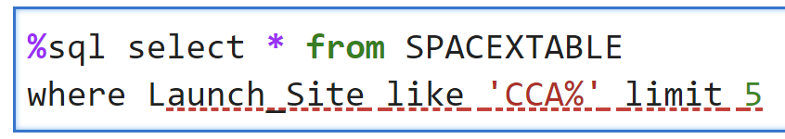
Launch Site Names Begin with 'CCA'
The first 5 records where launch sites begin with `CCA`
SQL used

Slide 27
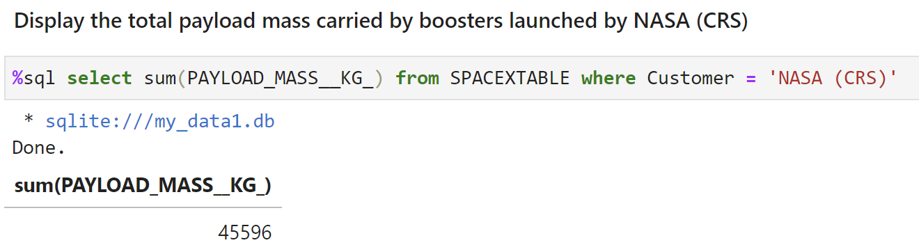
Total Payload Mass

Slide 28
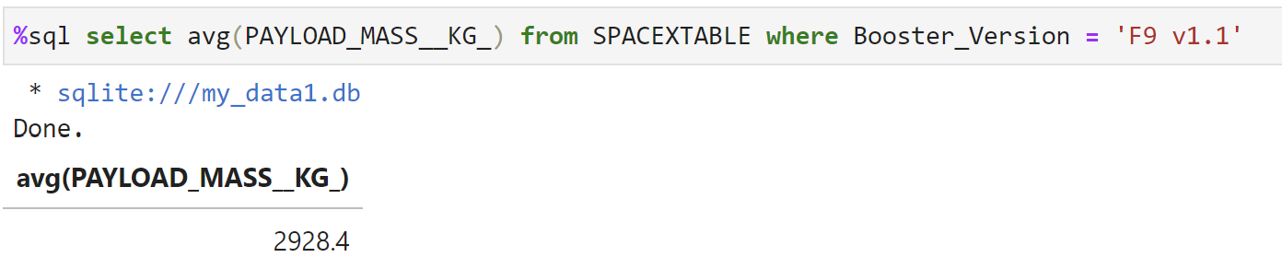
Average Payload Mass by F9 v1.1

Slide 29
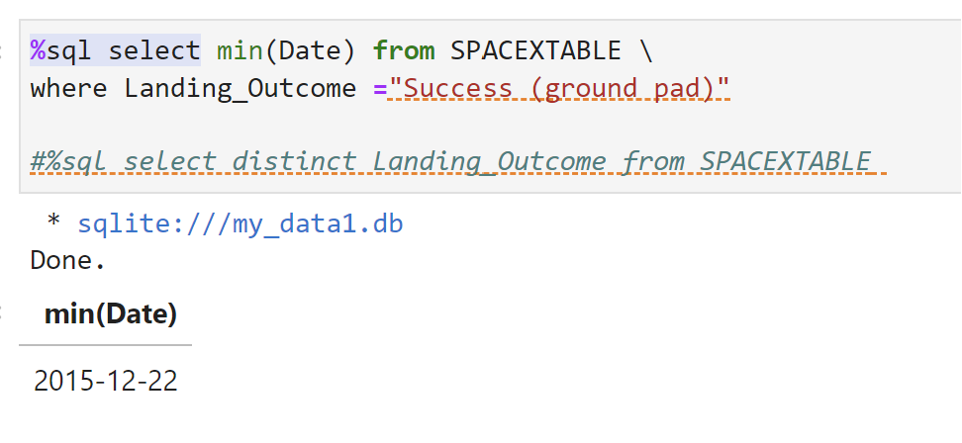
First Successful Ground Landing Date
First Successful Date on Ground

Slide 30
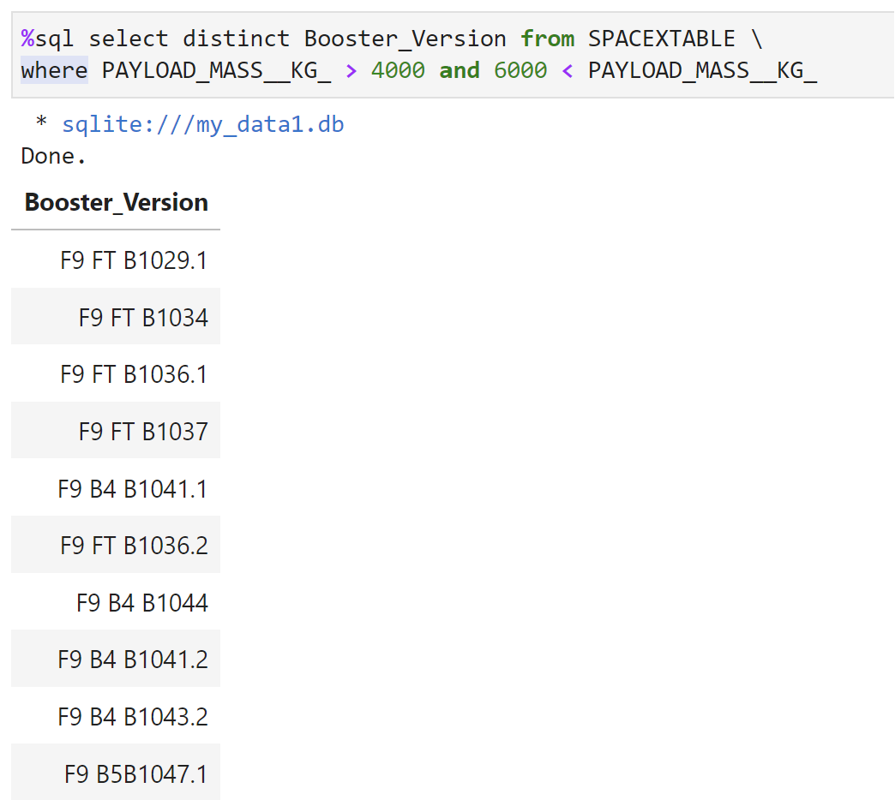
Successful Drone Ship Landing with Payload between 4000 and 6000
The names of boosters which have successfully landed on drone ship and had payload mass greater than 4000 but less than 6000

Slide 31
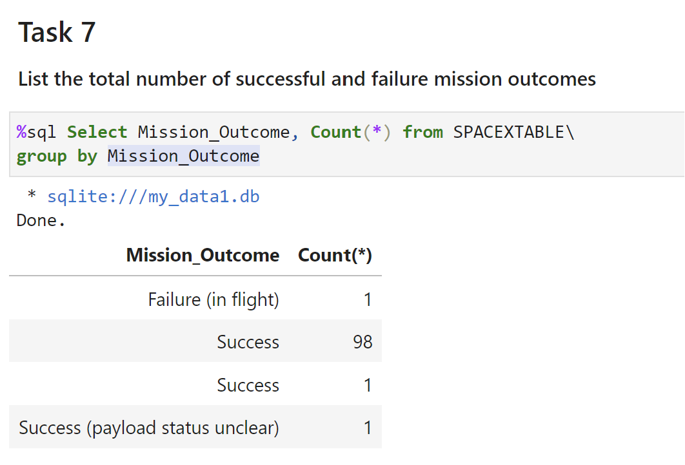
Total Number of Successful and Failure Mission Outcomes
The total number of successful and failure mission outcomes :
1 Failure, 99 Success, 1 Success with payload status unknown

Slide 32
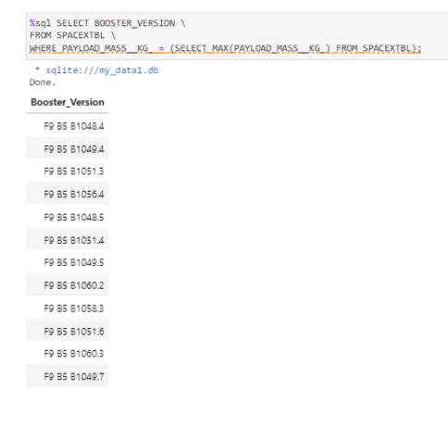
Boosters Carried Maximum Payload

Slide 33
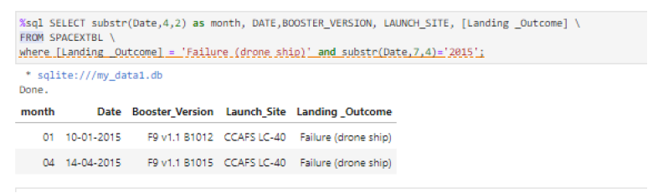
2015 Launch Records
Fail list in 2015

Slide 34
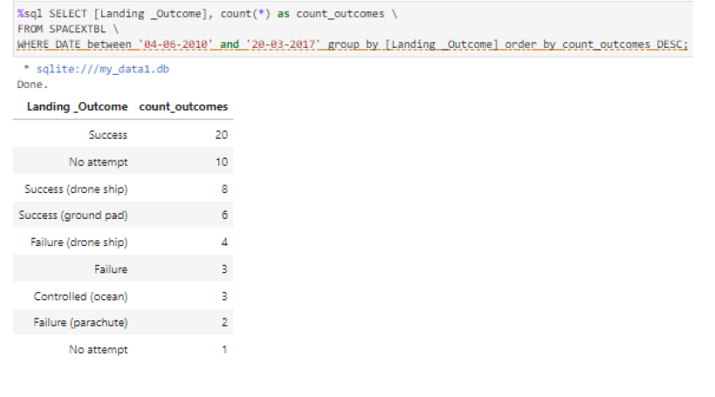
Rank Landing Outcomes Between 2010-06-04 and 2017-03-20

Slide 35

Section 3

Slide 36
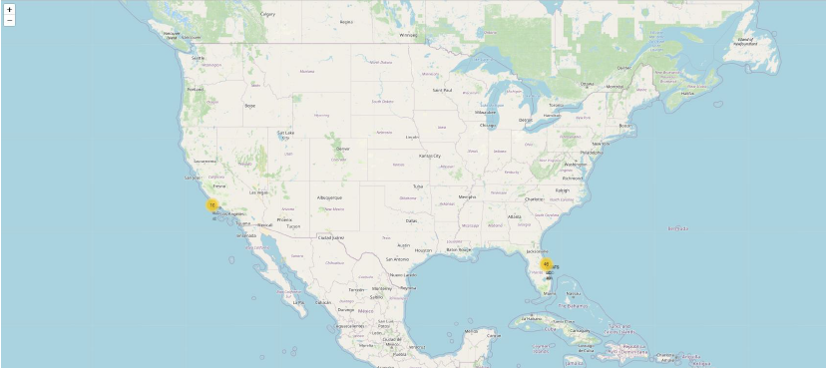
Launch Site Map
Near Equator: the closer the launch site to the equator, the easier it is to launchto equatorial orbit, and the more help you get from Earth's rotation for a prograde orbit. Rockets launched from sites near the equator get an additional natural boost-due to the rotational speed of earth -that helps save the costof putting in extra fuel and boosters.

Slide 37
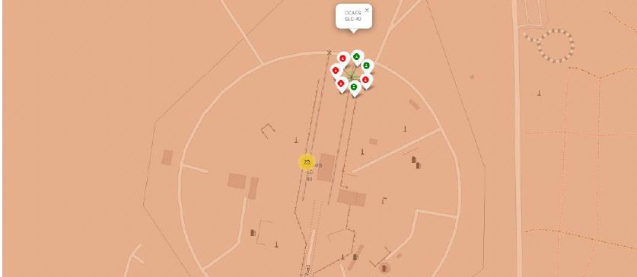
Launch Outcomes
At Each Launch Site
Outcomes:
Green markers for successful launches
Red markers for unsuccessful launches
Success rate of CCAFS SLC-40 is 42.9%

Slide 38
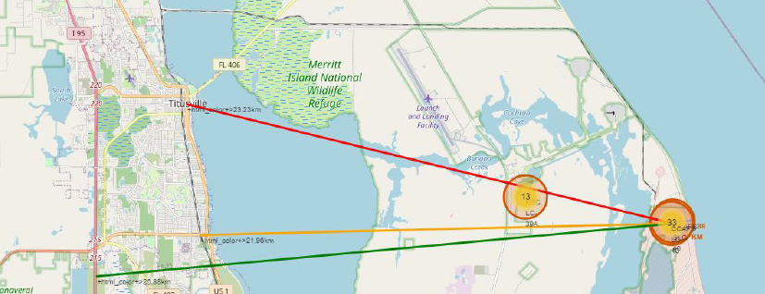
Proximities Map

Slide 39

Section 4

Slide 40
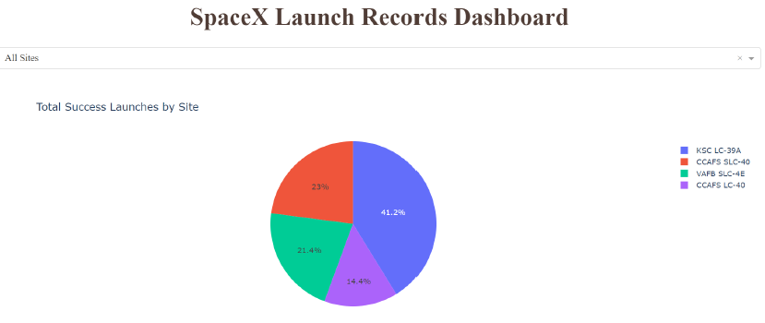
Launch Success Rate by Site
Success Rate Percentage
KSC LC-39A has the most successful launches amongst launch sites (41.2%)

Slide 41
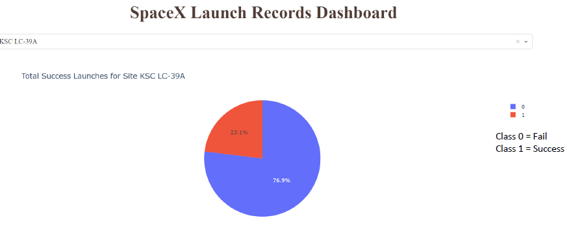
Launch Success (KSC LC-29A)
Success as Percent of Total
KSC LC-39A has the highest success rate amongst launch sites (76.9%)
10 successful launches and 3 failed launches

Slide 42
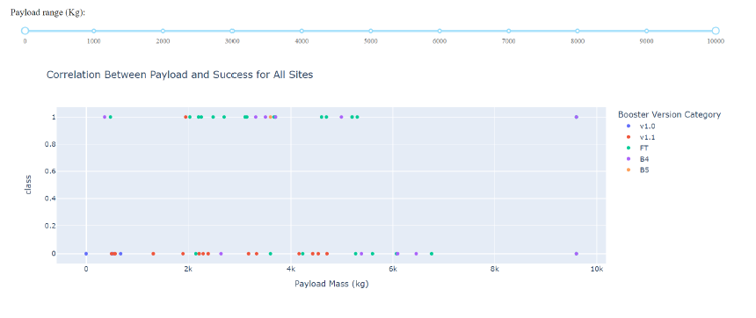
Payload vs. Launch Outcome
By Booster Version
Payloads between2,000 kg and 5,000 kg have the highest success rate
1 indicating successful outcome and 0 indicating an unsuccessful outcome

Slide 43

Section 5

Slide 44
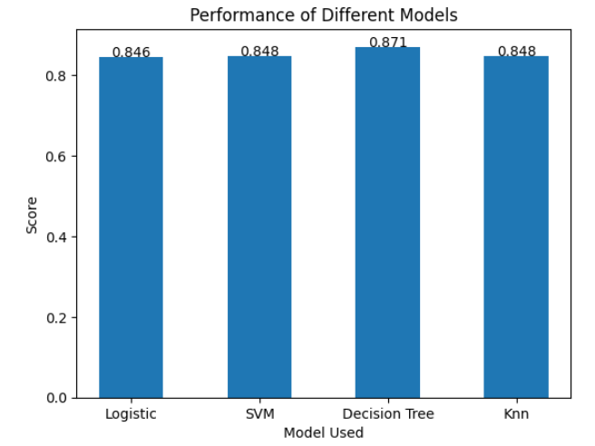
Classification Accuracy
The model of best performance is decision tree, which is 87.1%

Slide 45
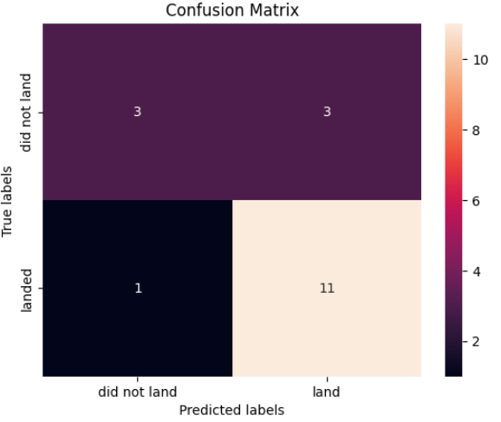
Confusion Matrix
The Type I error is 50%, which is not good.

Slide 46
Conclusions
Launch Site: Most of the launch sites are near the equator
•Launch Success Rate: generally increases over time
• KSC LC-39A has the highest success rate among launch sites. 100% success rate reached for launches less than 5,500 kg
• Orbits ES-L1, GEO, HEO, and SSO have a 100% success rate
• Payload Mass: Across all launch sites, the higher the payload mass (kg), the higher the success rate
Model Performance: The models performed similarly on the test set with the decision tree model slightly outperforming

Slide 47


